Slide 1

Python Data Manipulation &Cleansing
Dr. Jia Uddin
AI and Big Data Department
Endicott College, Woosong University
Daejeon, South Korea
Email: jia.Uddin@wsu.ac.kr

Slide 2
Find the lowest and highest value in an iterable
x = min(5, 10, 25)
y = max(5, 10, 25)
print(x)
print(y)

Slide 3
Return the absolute value of a number
x = abs(-7.25)
print(x)

Slide 4
Return the value of x to the power of y number
x = pow(4, 3)
print(x)

Slide 5
Return the square root of a number
import math
x = math.sqrt(64)
print(x)

Slide 6
Round a number upwards and downwards to its nearest integer
#Import math library
import math
#Round a number upward to its nearest integer
x = math.ceil(1.4)
#Round a number downward to its nearest integer
y = math.floor(1.4)
print(x)
print(y)

Slide 7
Access the elements of an array
cars = ["Ford", "Volvo", "BMW"]
x = cars[0]
print(x)

Slide 8
Loop through all elements of an array
cars = ["Ford", "Volvo", "BMW"]
for x in cars:
print(x)

Slide 9
Loop through all elements of an array
cars = ["Ford", "Volvo", "BMW"]
for x in cars:
print(x)

Slide 10
Add an element to an array
cars = ["Ford", "Volvo", "BMW"]
cars.append(“KIA")
print(cars)

Slide 11
Remove an element from an array
cars = ["Ford", "Volvo", "BMW"]
cars.pop(1)
print(cars)

Slide 12
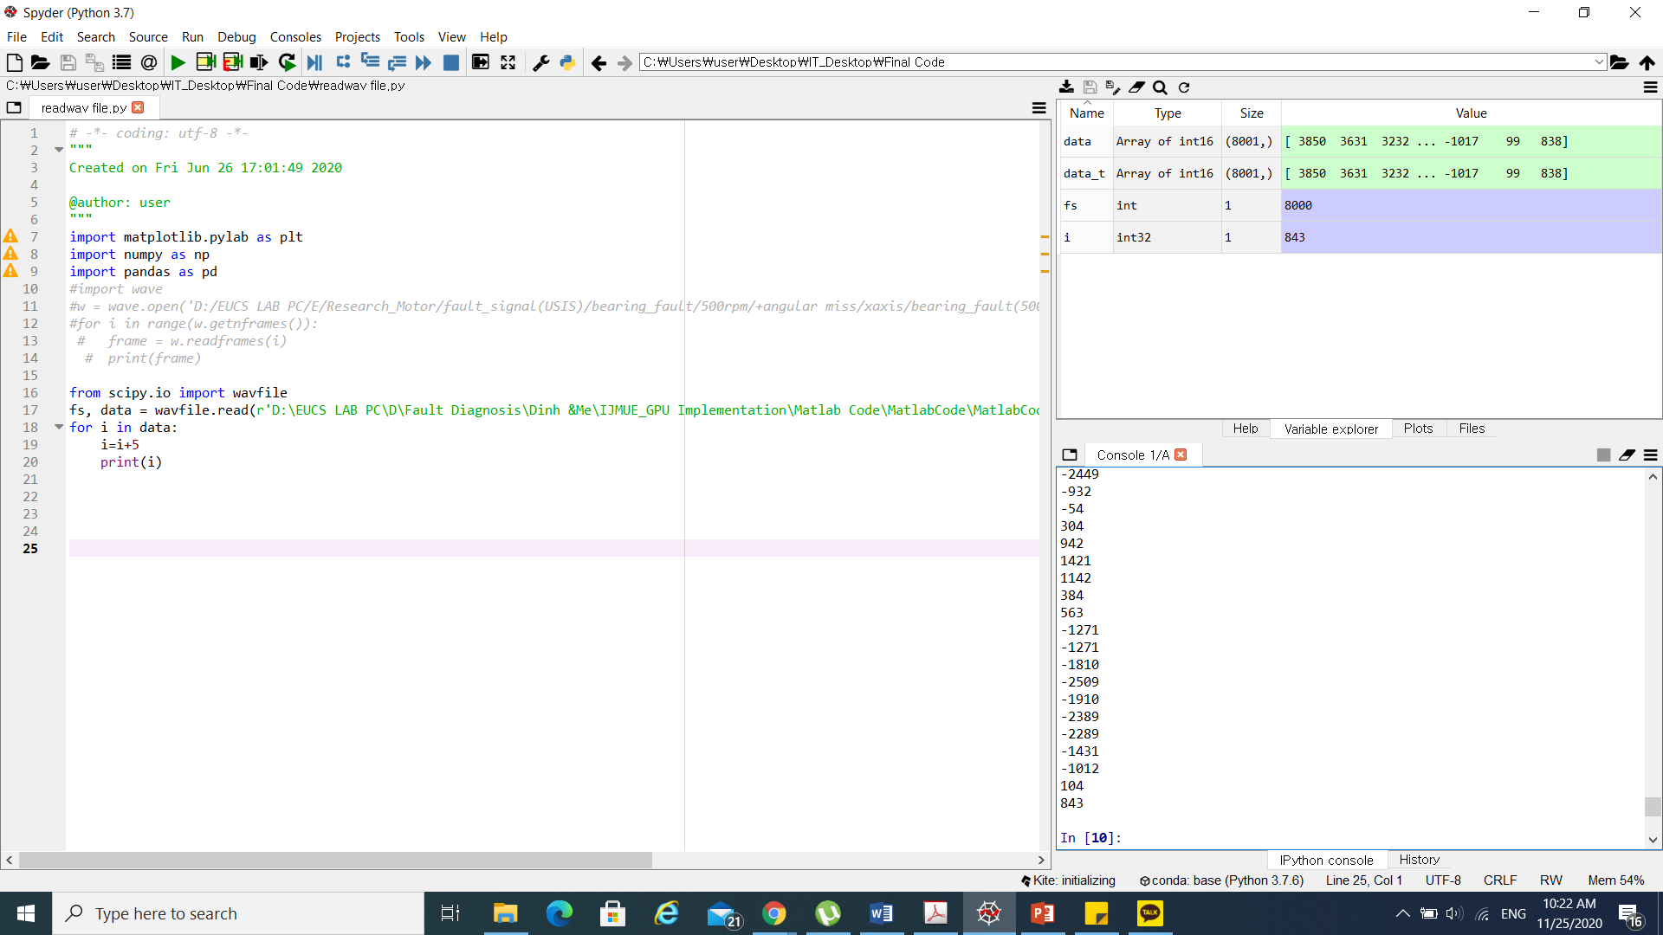
Add an element to an array
import matplotlib.pylab as plt
import numpy as np
import pandas as pd
#import wave
#w = wave.open('D:/EUCS LAB PC/E/Research_Motor/fault_signal(USIS)/bearing_fault/500rpm/+angular miss/xaxis/bearing_fault(500rpm)+angular_miss_xaxis_1.wav', 'r')
#for i in range(w.getnframes()):
# frame = w.readframes(i)
# print(frame)
from scipy.io import wavfile
fs, data = wavfile.read(r'D:\EUCS LAB PC\D\Fault Diagnosis\Dinh &Me\IJMUE_GPU Implementation\Matlab Code\MatlabCode\MatlabCode\Final_program_V2_SrW(21)_NbW(13)_Gap(5)\fault_signal\am\pm105.wav', 'r')
for i in data:
i=i+5
print(i)

Slide 13
Add an element to an array
import matplotlib.pylab as plt
import numpy as np
import pandas as pd
#import wave
#w = wave.open('D:/EUCS LAB PC/E/Research_Motor/fault_signal(USIS)/bearing_fault/500rpm/+angular miss/xaxis/bearing_fault(500rpm)+angular_miss_xaxis_1.wav', 'r')
#for i in range(w.getnframes()):
# frame = w.readframes(i)
# print(frame)
from scipy.io import wavfile
fs, data = wavfile.read(r'D:\EUCS LAB PC\D\Fault Diagnosis\Dinh &Me\IJMUE_GPU Implementation\Matlab Code\MatlabCode\MatlabCode\Final_program_V2_SrW(21)_NbW(13)_Gap(5)\fault_signal\am\pm105.wav', 'r')
for i in data:
i=i+5
print(i)

Slide 14
Add an element to an array
import matplotlib.pylab as plt
import numpy as np
import pandas as pd
#import wave
#w = wave.open('D:/EUCS LAB PC/E/Research_Motor/fault_signal(USIS)/bearing_fault/500rpm/+angular miss/xaxis/bearing_fault(500rpm)+angular_miss_xaxis_1.wav', 'r')
#for i in range(w.getnframes()):
# frame = w.readframes(i)
# print(frame)
from scipy.io import wavfile
fs, data = wavfile.read(r'D:\EUCS LAB PC\D\Fault Diagnosis\Dinh &Me\IJMUE_GPU Implementation\Matlab Code\MatlabCode\MatlabCode\Final_program_V2_SrW(21)_NbW(13)_Gap(5)\fault_signal\am\pm105.wav', 'r')
for i in data:
i=i+5
print(i)

Slide 15
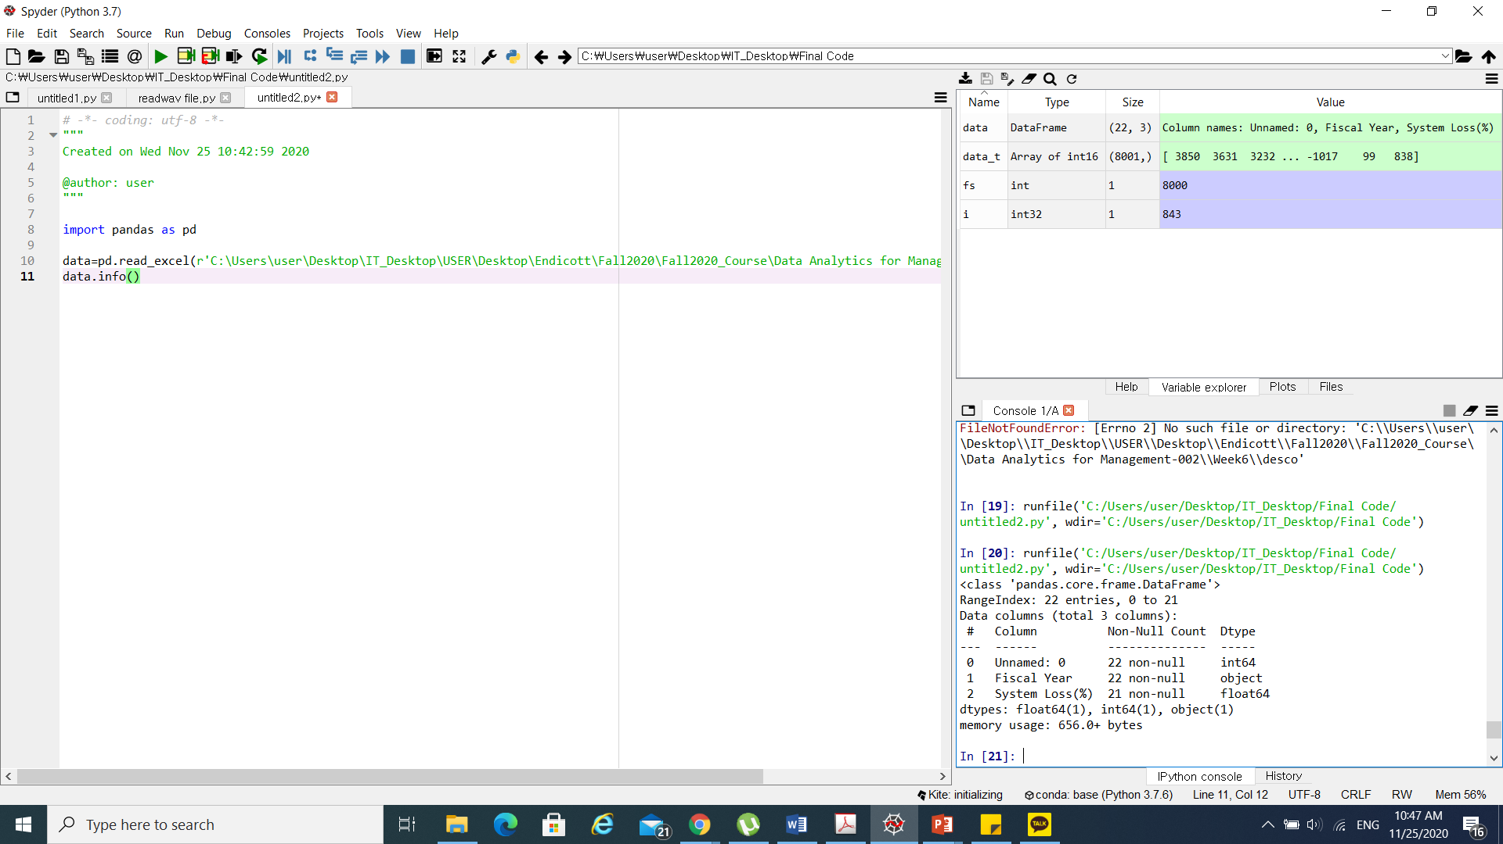
Viewing Data
data.info()

Slide 16

Viewing Data(up to n)
data.sample(10)
Data.head(10)
Data.tail(10)
Notes:
https://towardsdatascience.com/data-talks-a-practical-tutorial-on-data-manipulation-with-pandas-6a4715382a1

Slide 17
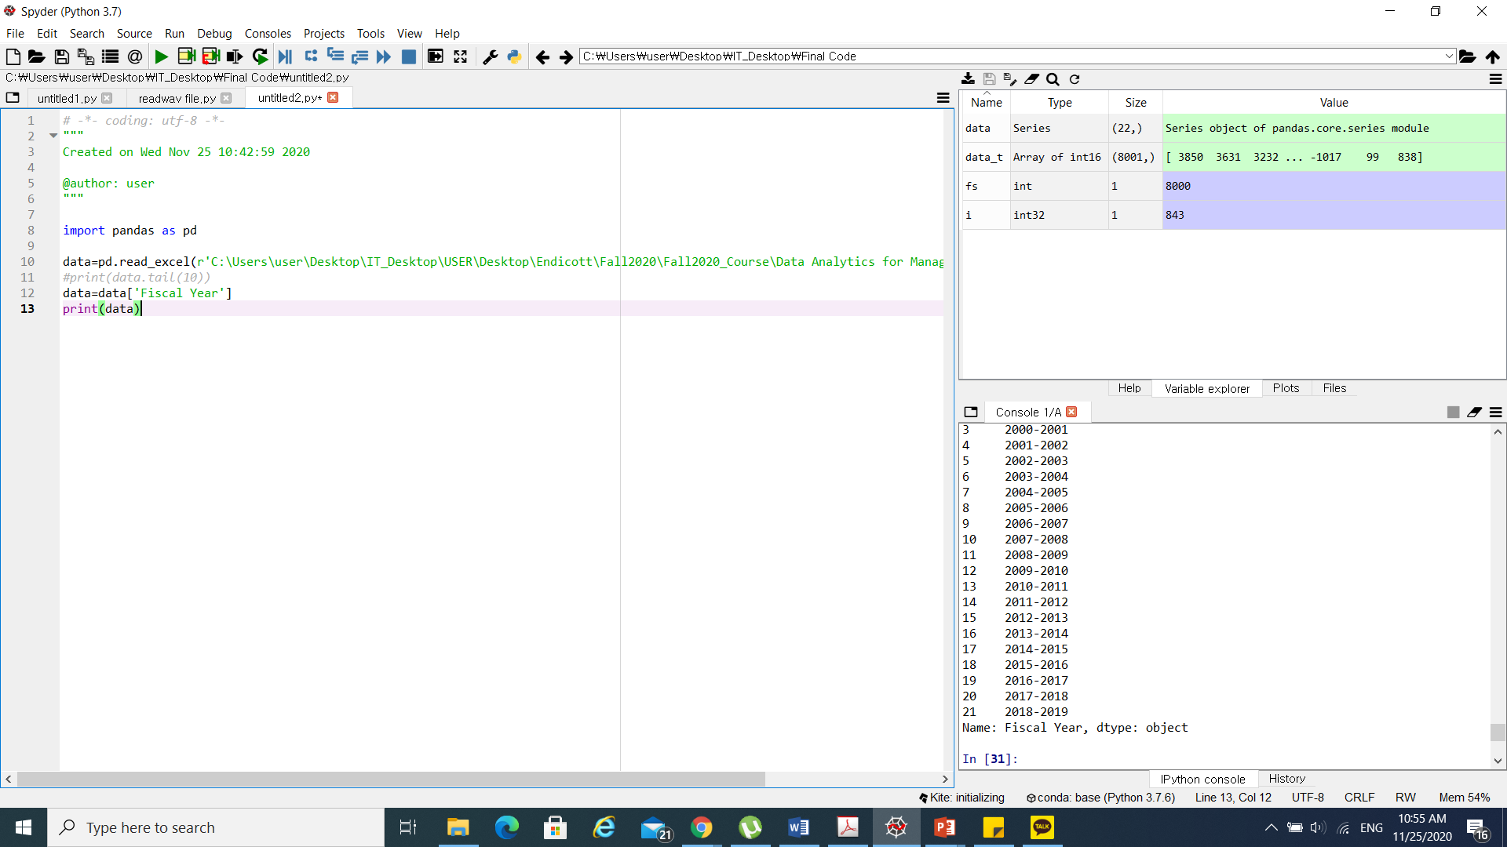
Return a series(1D/2D)
import pandas as pd
data=pd.read_excel(r'C:\Users\user\Desktop\IT_Desktop\USER\Desktop\Endicott\Fall2020\Fall2020_Course\Data Analytics for Management-002\Week6\desco.xlsx')
#print(data.tail(10))
data=data['Fiscal Year']
print(data)

Slide 18
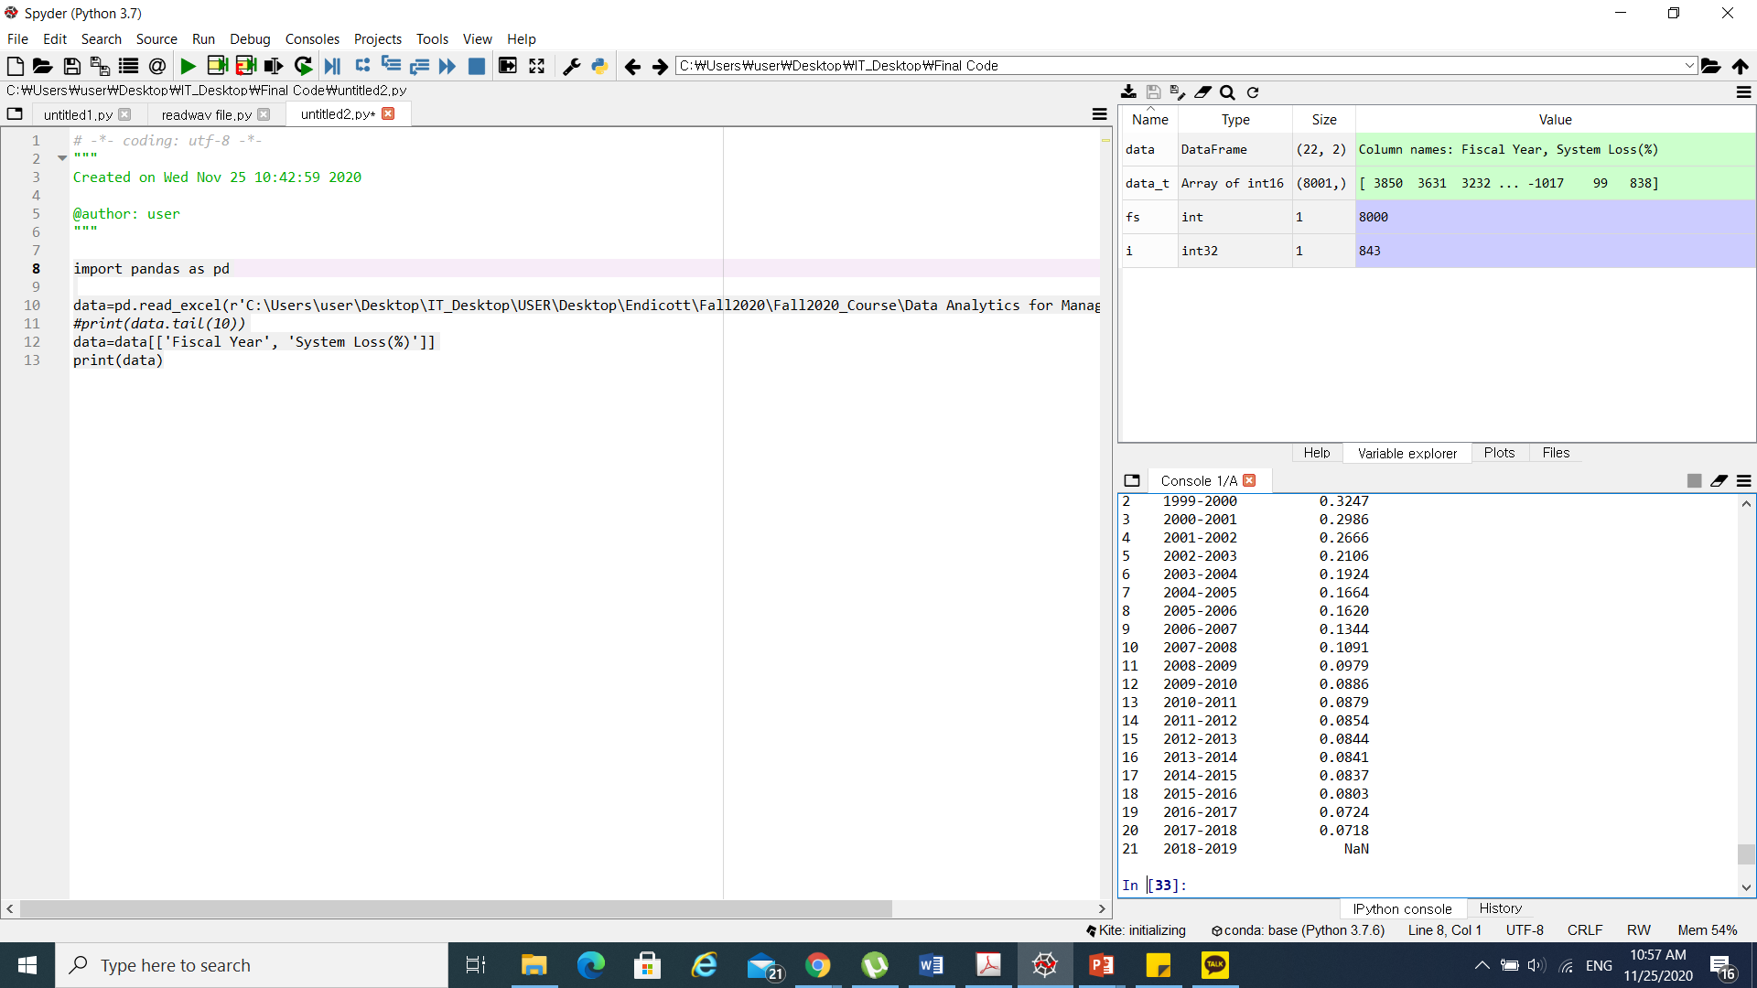
Return a series(1D/2D)
import pandas as pd
data=pd.read_excel(r'C:\Users\user\Desktop\IT_Desktop\USER\Desktop\Endicott\Fall2020\Fall2020_Course\Data Analytics for Management-002\Week6\desco.xlsx')
#print(data.tail(10))
data=data[['Fiscal Year', 'System Loss(%)']]
print(data)

Slide 19
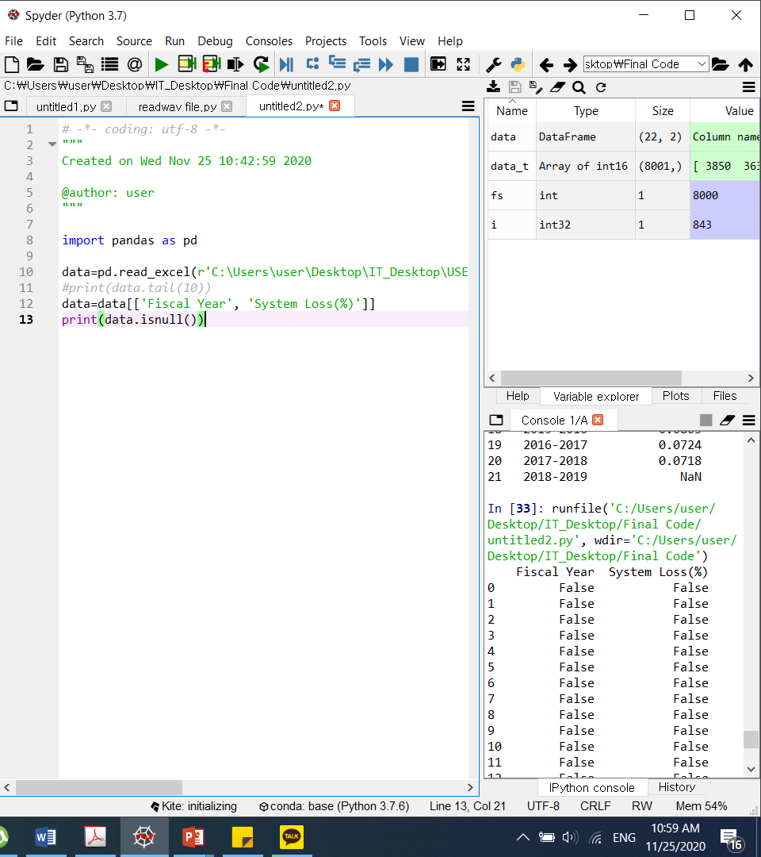
Cleaning Data
import pandas as pd
data=pd.read_excel(r'C:\Users\user\Desktop\IT_Desktop\USER\Desktop\Endicott\Fall2020\Fall2020_Course\Data Analytics for Management-002\Week6\desco.xlsx')
#print(data.tail(10))
data=data[['Fiscal Year', 'System Loss(%)']]
print(data.isnull())
Notes:
https://towardsdatascience.com/data-talks-a-practical-tutorial-on-data-manipulation-with-pandas-6a4715382a1

Slide 20
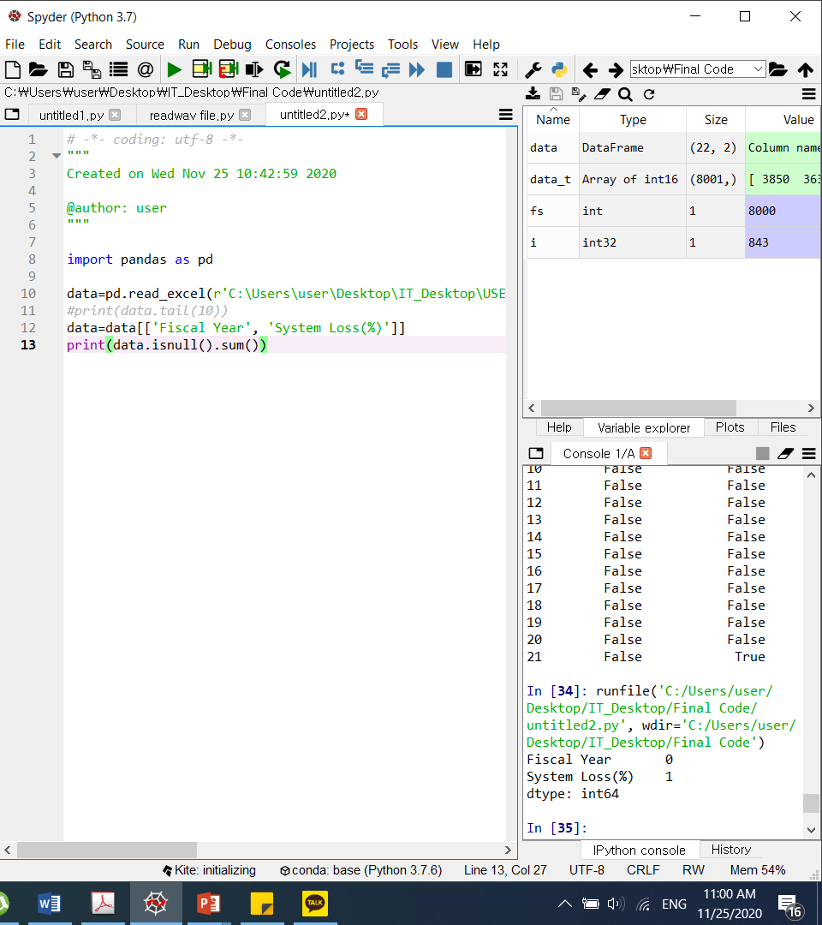
Cleaning Data
import pandas as pd
data=pd.read_excel(r'C:\Users\user\Desktop\IT_Desktop\USER\Desktop\Endicott\Fall2020\Fall2020_Course\Data Analytics for Management-002\Week6\desco.xlsx')
#print(data.tail(10))
data=data[['Fiscal Year', 'System Loss(%)']]
print(data.isnull().sum())
Notes:
https://towardsdatascience.com/data-talks-a-practical-tutorial-on-data-manipulation-with-pandas-6a4715382a1

Slide 21
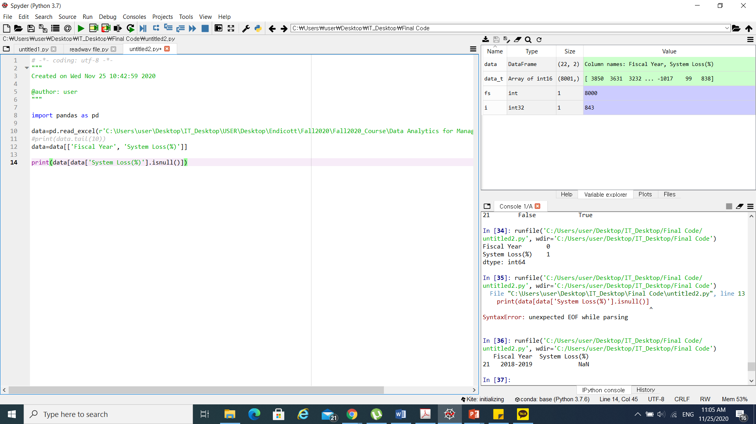
Cleaning Data(investigate null values)
import pandas as pd
data=pd.read_excel(r'C:\Users\user\Desktop\IT_Desktop\USER\Desktop\Endicott\Fall2020\Fall2020_Course\Data Analytics for Management-002\Week6\desco.xlsx')
#print(data.tail(10))
data=data[['Fiscal Year', 'System Loss(%)']]
print(data[data['System Loss(%)'].isnull()])
Notes:
https://towardsdatascience.com/data-talks-a-practical-tutorial-on-data-manipulation-with-pandas-6a4715382a1

Slide 22
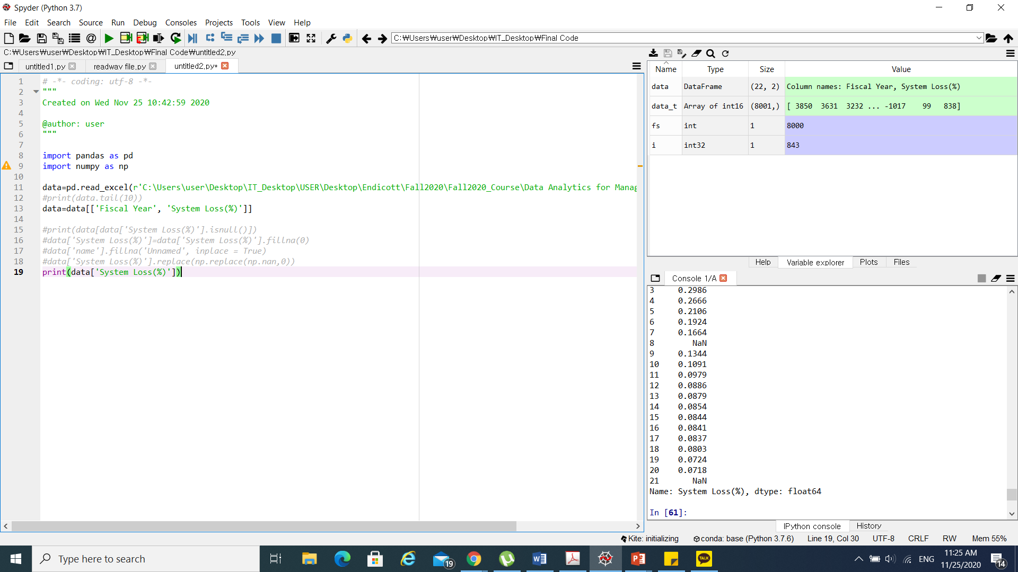
Replace the NaN value by ‘0’
import pandas as pd
import numpy as np
data=pd.read_excel(r'C:\Users\user\Desktop\IT_Desktop\USER\Desktop\Endicott\Fall2020\Fall2020_Course\Data Analytics for Management-002\Week6\desco.xlsx')
#print(data.tail(10))
data=data[['Fiscal Year', 'System Loss(%)']]
#print(data[data['System Loss(%)'].isnull()])
#data['System Loss(%)']=data['System Loss(%)'].fillna(0)
#data['name'].fillna('Unnamed', inplace = True)
#data['System Loss(%)'].replace(np.replace(np.nan,0))
print(data['System Loss(%)'])

Slide 23

Replace the NaN value by ‘0’
import pandas as pd
import numpy as np
data=pd.read_excel(r'C:\Users\user\Desktop\IT_Desktop\USER\Desktop\Endicott\Fall2020\Fall2020_Course\Data Analytics for Management-002\Week6\desco.xlsx')
#print(data.tail(10))
data=data[['Fiscal Year', 'System Loss(%)']]
#print(data[data['System Loss(%)'].isnull()])
data['System Loss(%)']=data['System Loss(%)'].fillna(0)
#data['name'].fillna('Unnamed', inplace = True)
#data['System Loss(%)'].replace(np.replace(np.nan,0))
print(data['System Loss(%)'])

Slide 24
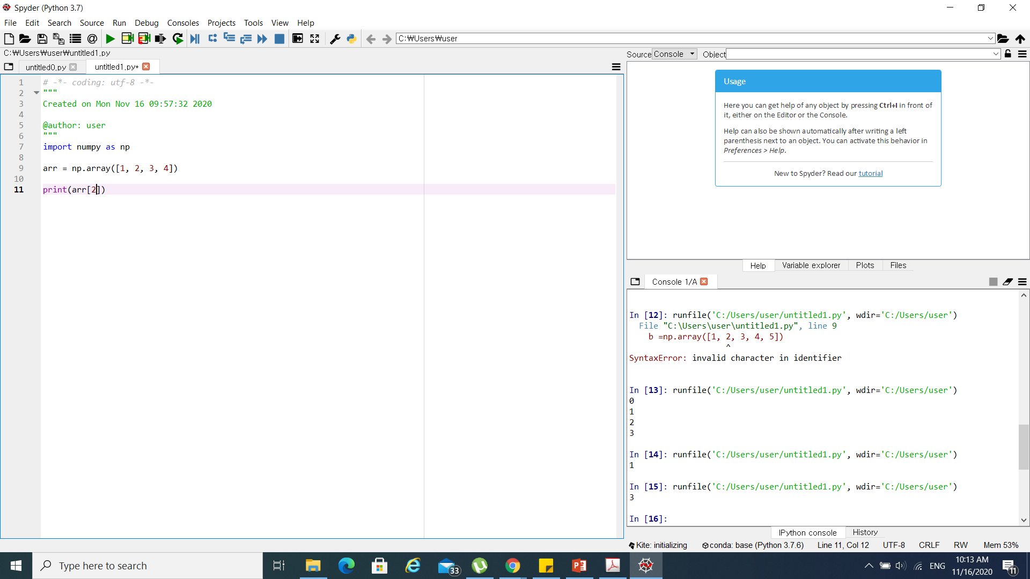
NumPy Array Indexing
import numpy as np
arr = np.array([1, 2, 3, 4])
print(arr[0])

Slide 25
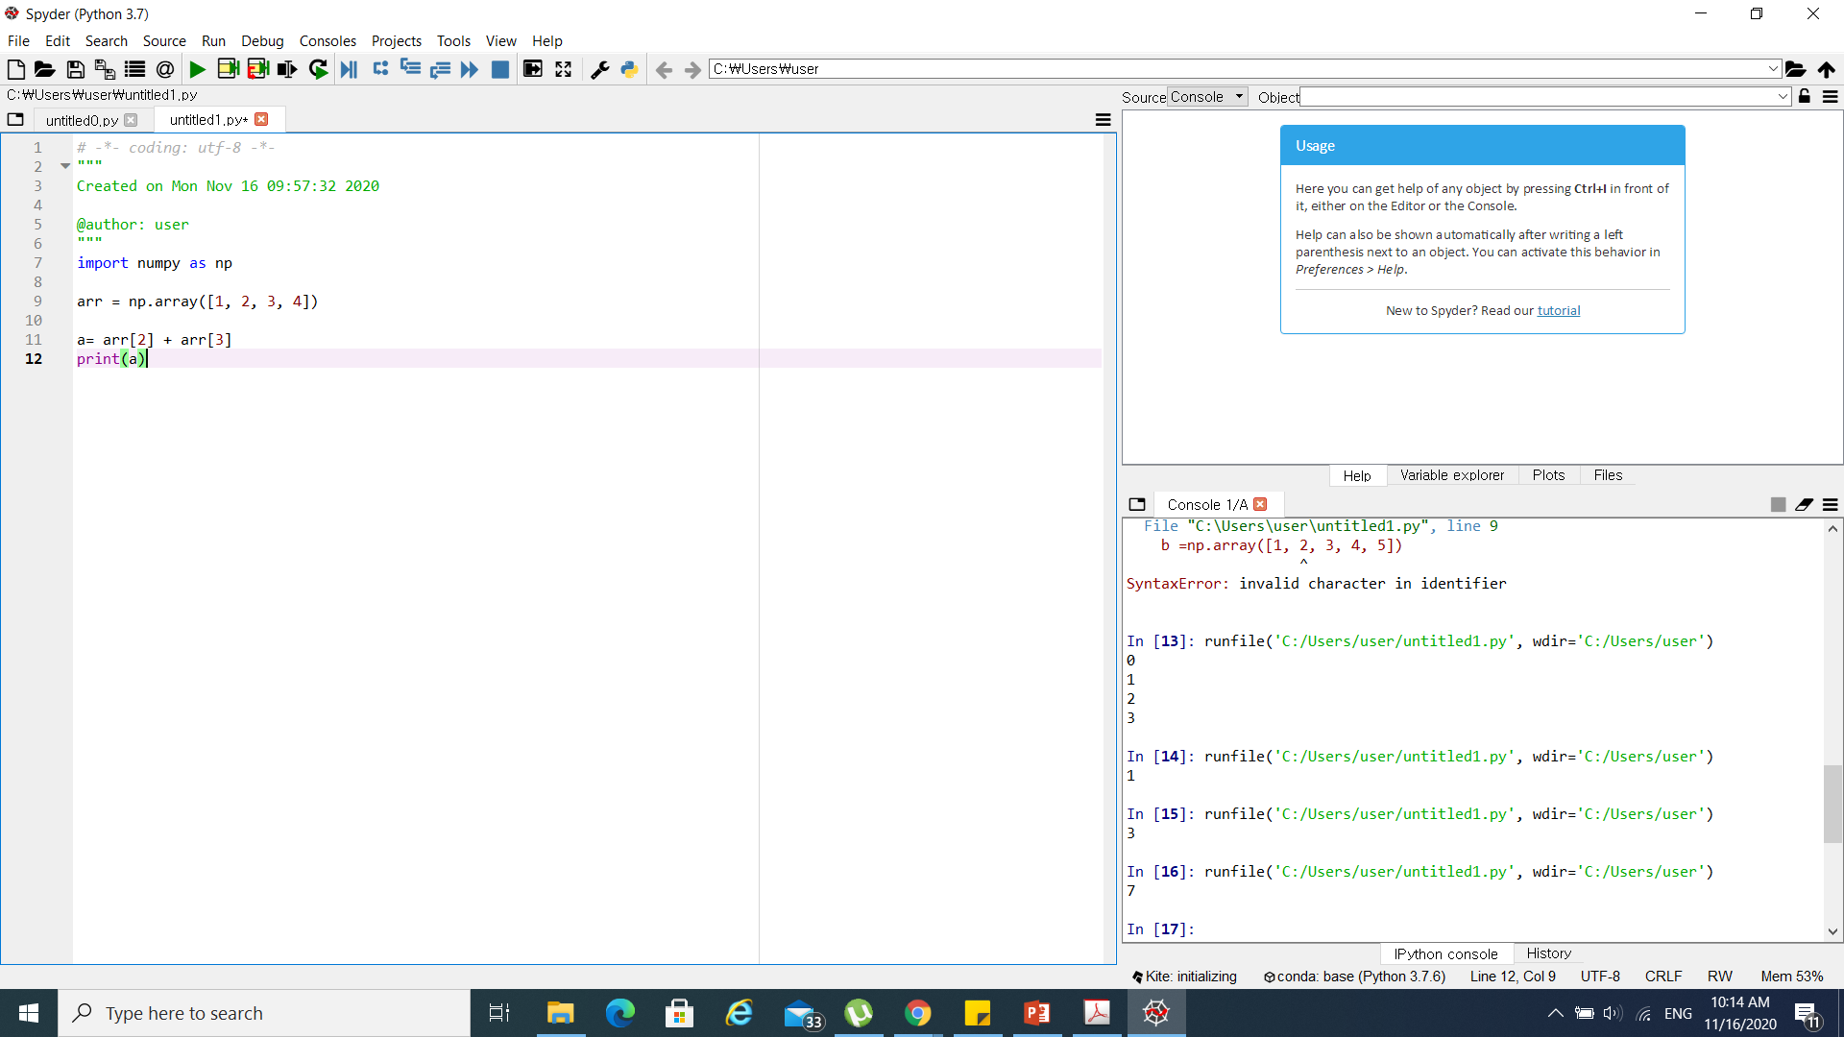
Addition of the array elements
import numpy as np
arr = np.array([1, 2, 3, 4])
print(arr[2] + arr[3])

Slide 26
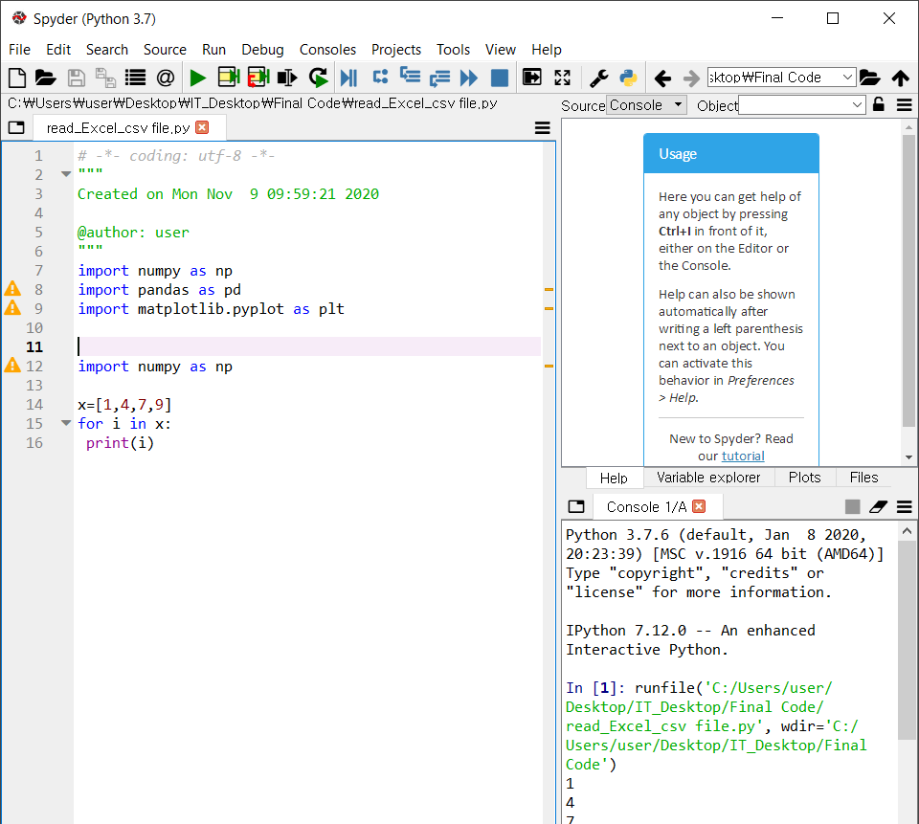
Iterating an 1D Array
import numpy as np
x=[1,4,7,9]
for i in x:
print(i)

Slide 27

Python Data Cleansing

Slide 28
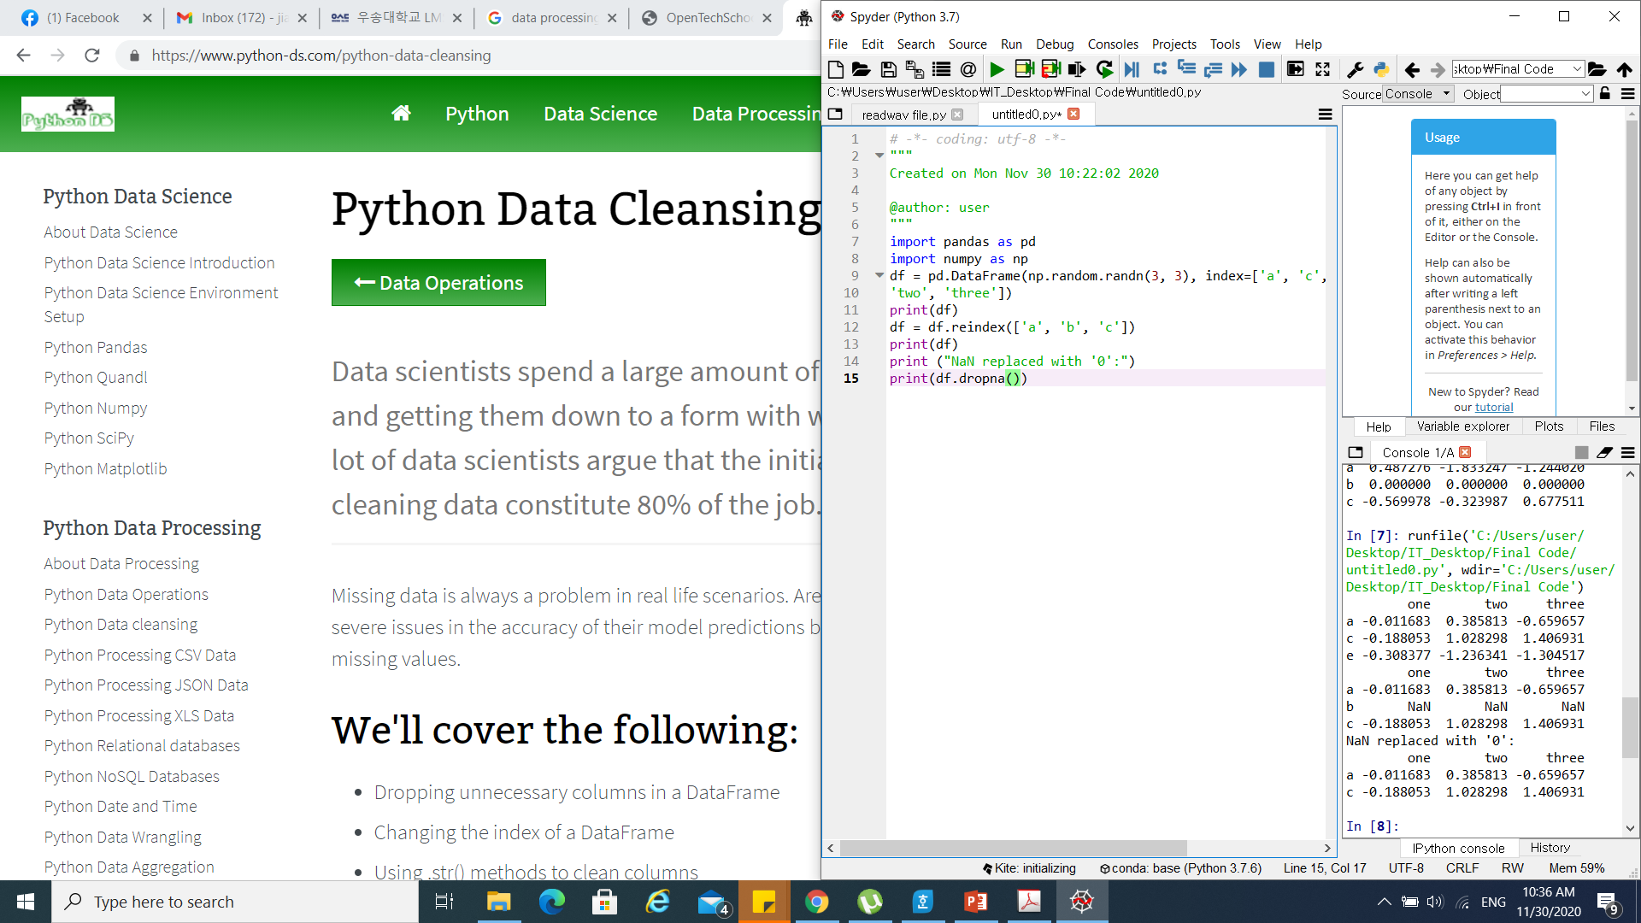
dropna()
Notes:
https://www.python-ds.com/python-data-cleansing

